Slide 1
FACULTY INFORMATION SYSTEM

Slide 2
TEAM MEMBERS :
Krishna Babu 21071A05F1
K Sai Shashidhar Reddy 21071A05F2
Pola Srinidhi 21071A05H5
R Sai Charan Goud 21071A05H7
S Vamshi Krishna 21071A05J2
V Pranavi 21071A05K1

Slide 3
ABSTRACT :
The efficient management of faculty timetables plays a crucial role in educational institutions, ensuring effective allocation of resources and optimized scheduling for smooth academic operations. This abstract presents an overview of a Faculty Information System (FIS) designed to streamline the process of creating, modifying, and managing timetables for faculty members in educational settings. FIS aims to automate and simplify the often complex and time-consuming task of creating and managing timetables for faculty members. So, the system provides an intuitive and user-friendly interface for administrators to generate optimized schedules that meet the needs of both faculty members and the institution. Moreover, the FIS provides real-time updates and notifications, ensuring that faculty members and administrators are aware of any changes or modifications to their schedules.
The implementation of the FIS can result in improved academic operations, enhanced collaboration, and better utilization of resources, ultimately contributing to a more effective education delivery.

Slide 4
OBJECTIVES :
Our objective for this project is to develop a web application that effectively manages and view faculty work allocations :
Promote Easy Faculty Timetable Access
Optimize resource allocation (Faculty Allocation)
Enhance productivity and performance among Faculty
Support decision-making and planning
Facilitate work evaluation and recognition

Slide 5
SOFTWARE TOOLS :
VS CODE
MONGODB COMPASS
MONGODB
REACTJS
NODEJS
EXPRESSJS

Slide 6
BACKEND DETAILS :
Our backend is built using Node.js and Express.js.
The database we used is MongoDb.
Node.js provides a powerful and efficient runtime environment for server-side applications.
Express.js is a flexible and minimalist framework that simplifies routing and middleware handling.
Middlewares : Middleware functions are essential for enhancing our backend's functionality.
APIS : Our APIs adhere to RESTful principles, making them intuitive and easy to use.They follow a structured approach with meaningful endpoint URLs and standard HTTP methods (GET, POST, PUT, DELETE).

Slide 7
APIS USED :
User API : The User API handles user-related operations like registration, login, and authentication. User data is securely stored in the MongoDB database.
Faculty Timetable API : The Faculty Timetable API manages faculty schedules and availability. It allows adding, updating, and retrieving timetable information.
Class Timetable API : The Class Timetable API handles class schedules and courses.It stores and retrieves class-specific data from the database.
Faculty List API : The Faculty List API manages the list of faculty members in the system. Faculty information is stored and accessed through this API.
Class-Faculty API : The Class-Faculty API handles faculty assignments to specific classes or courses. It maintains associations between faculty members and classes.
Free Hours API : The Free Hours API identifies and manages faculty members' free time slots. It ensures optimal faculty availability for different classes.

Slide 8
CODE :

Slide 9
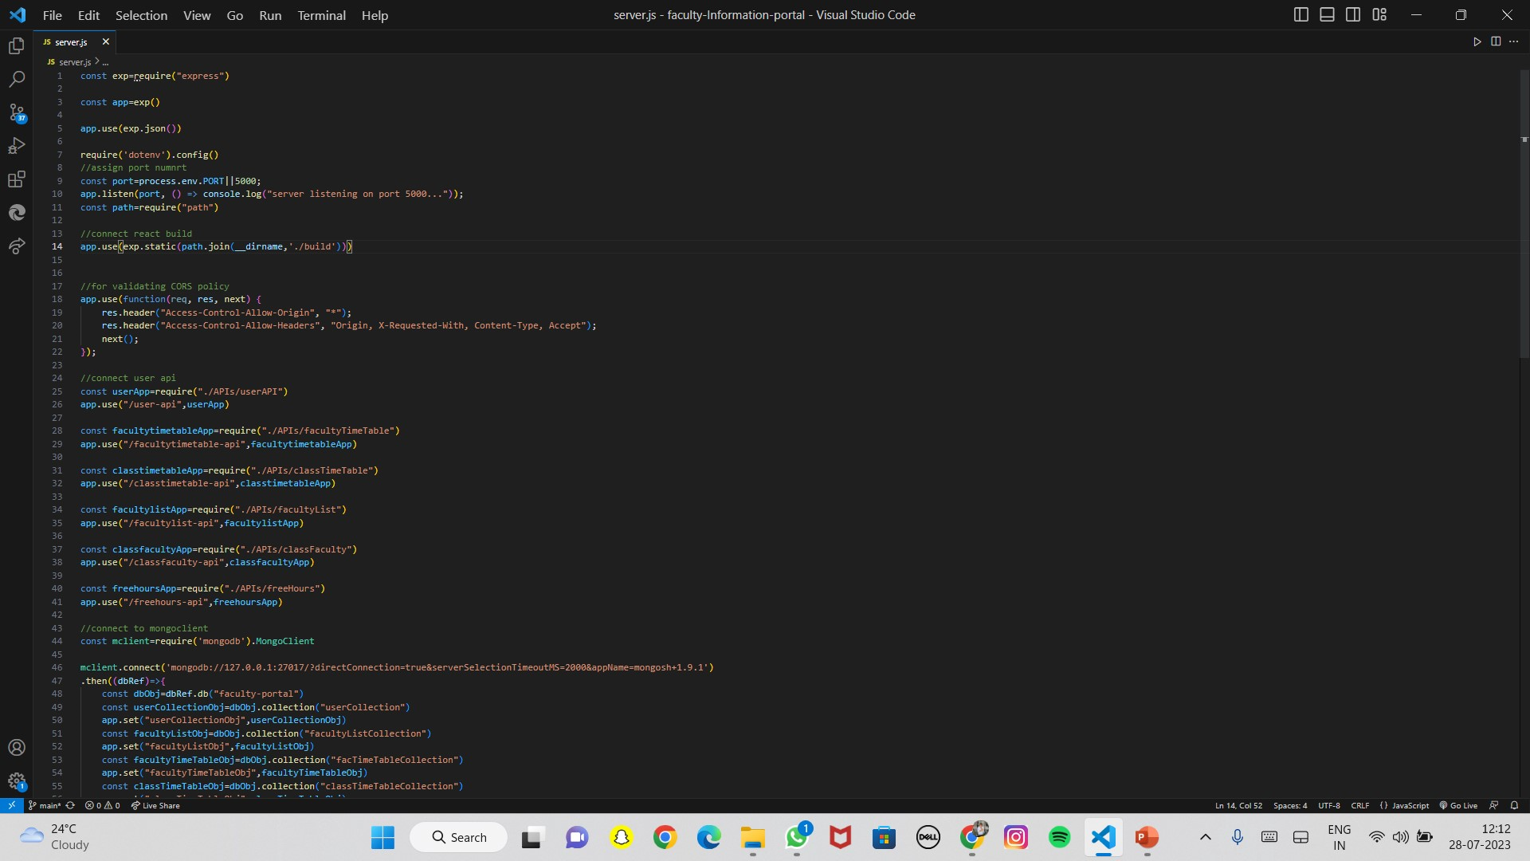
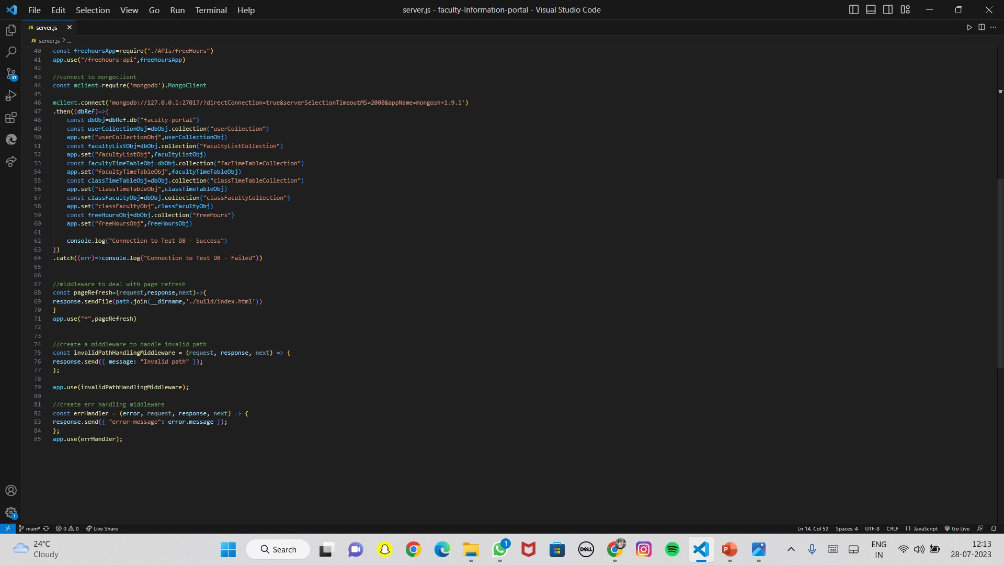
SERVER.JSX

Slide 10
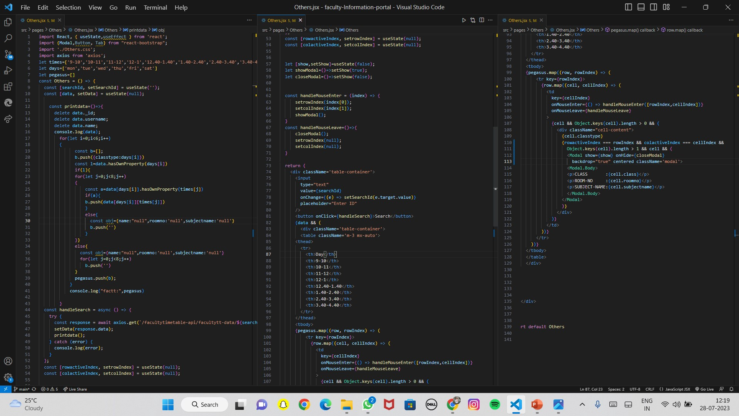
CLASS TIME TABLE.JSX

Slide 11
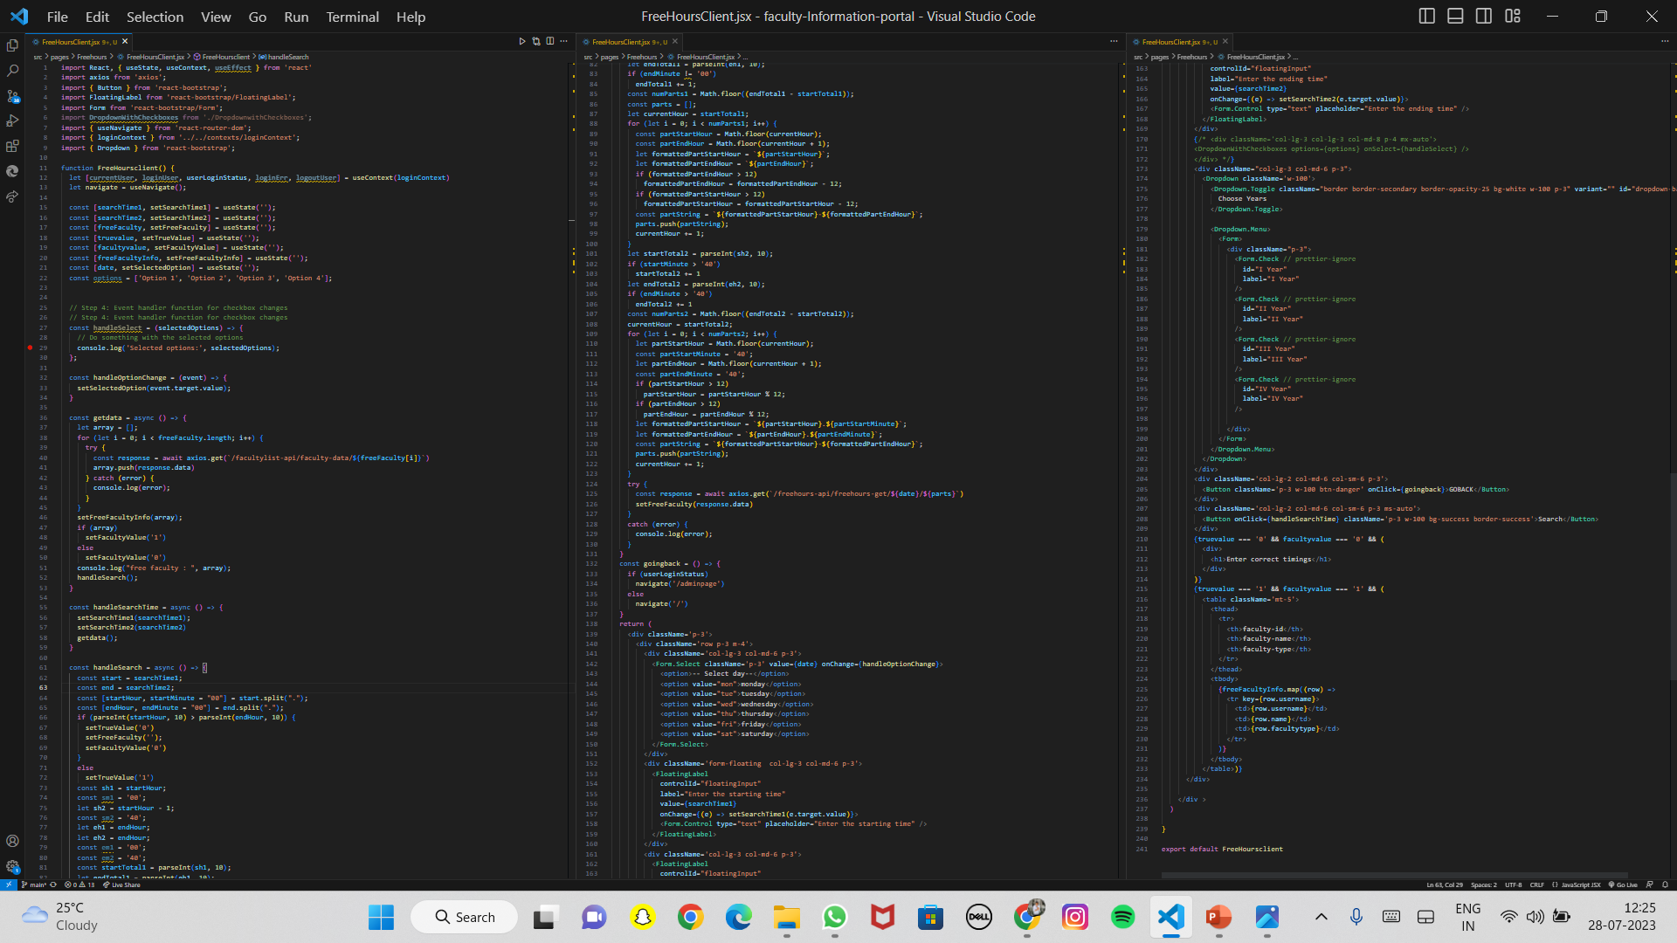
FREE HOURS.JSX

Slide 12
APPLICATION SCREENSHOTS:

Slide 13
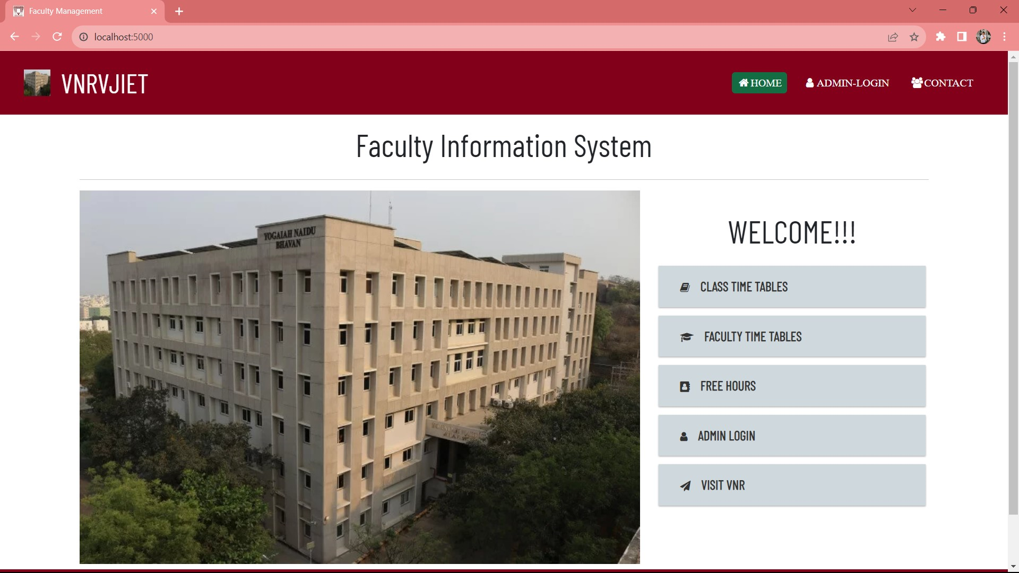
HOME PAGE

Slide 14
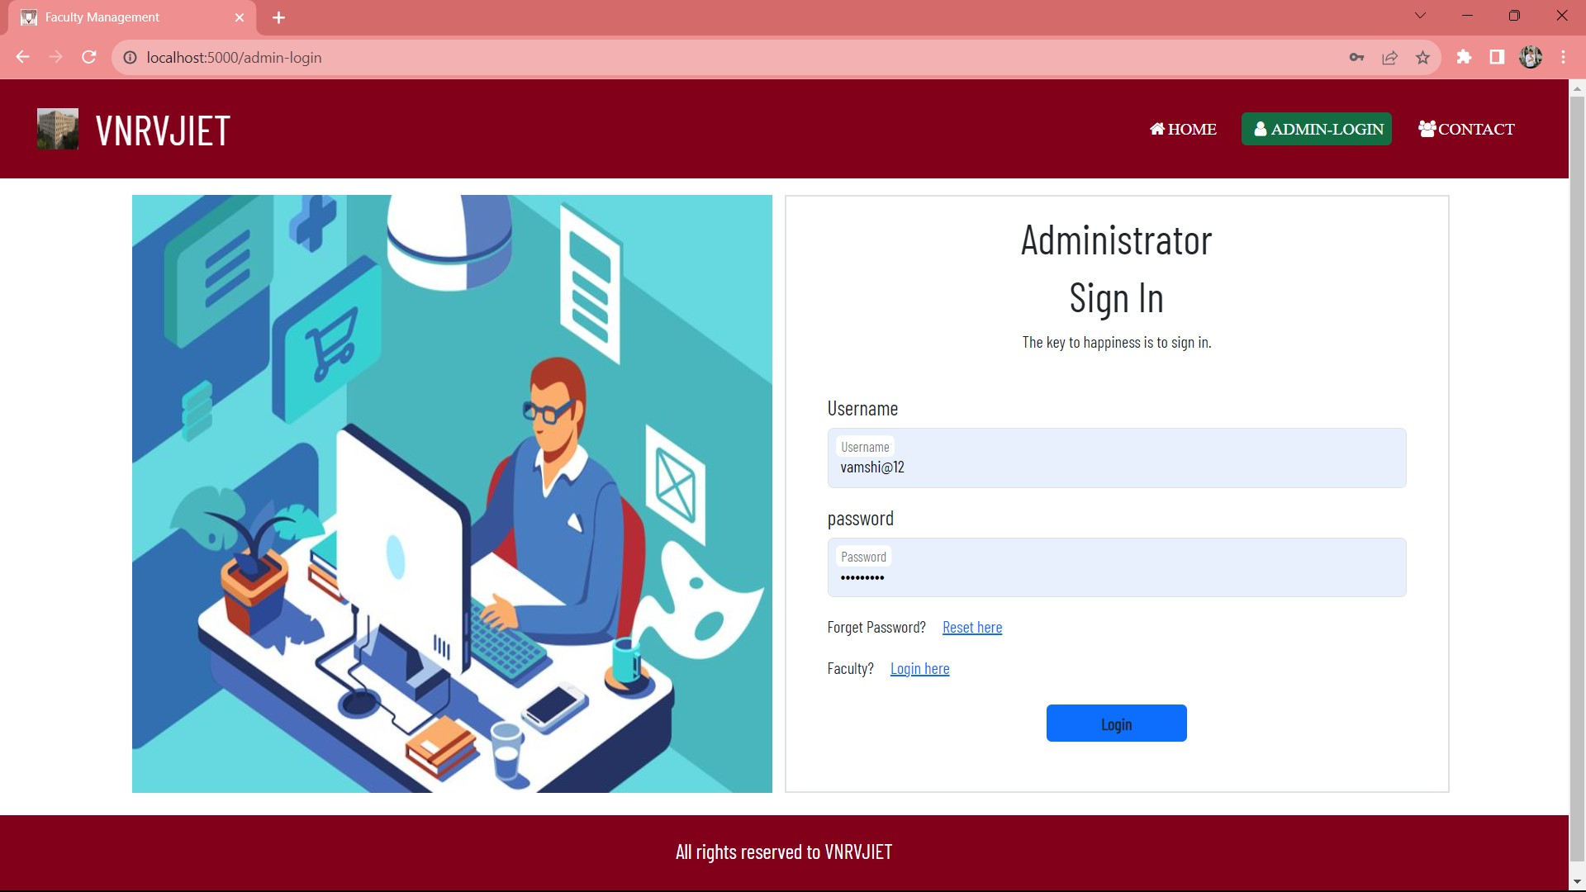
ADMIN LOGIN

Slide 15
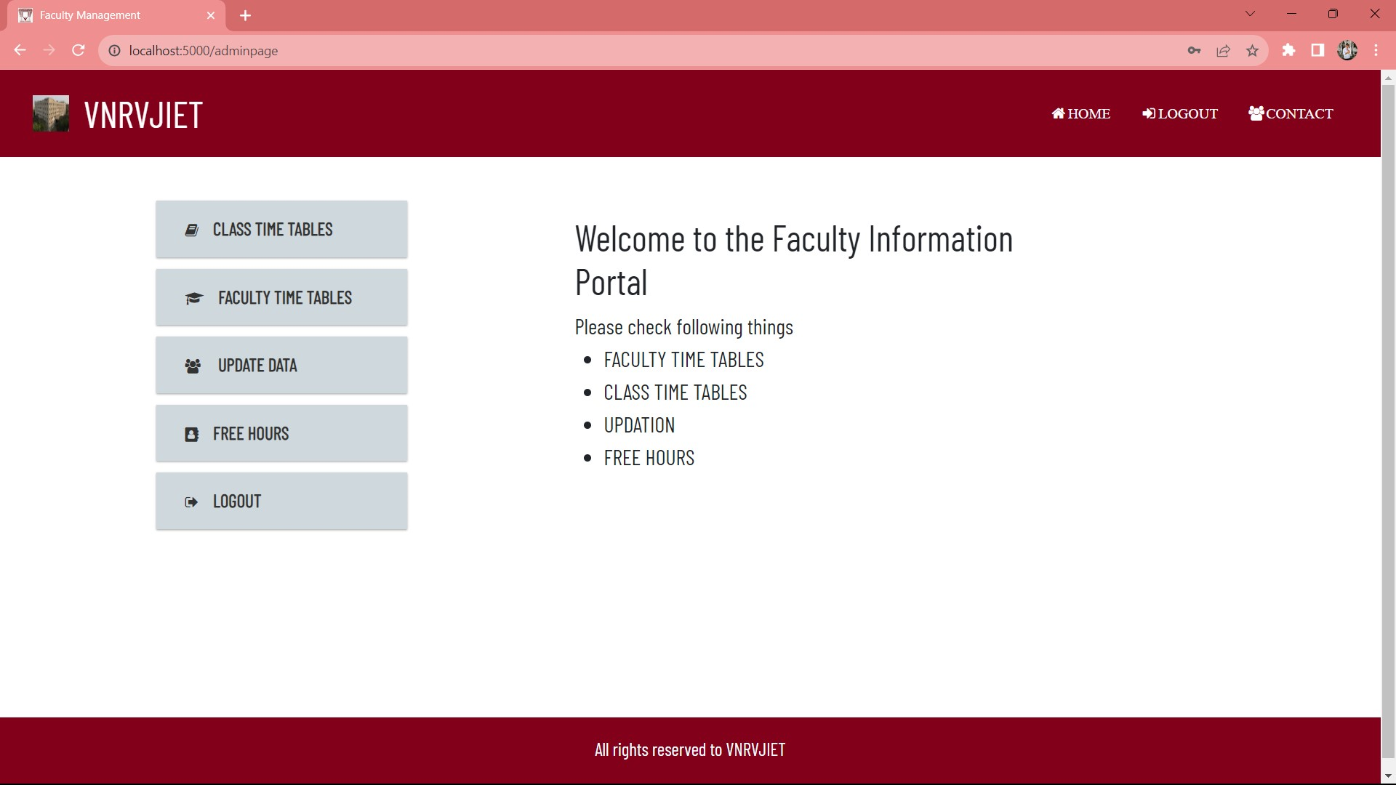
ADMIN PAGE

Slide 16
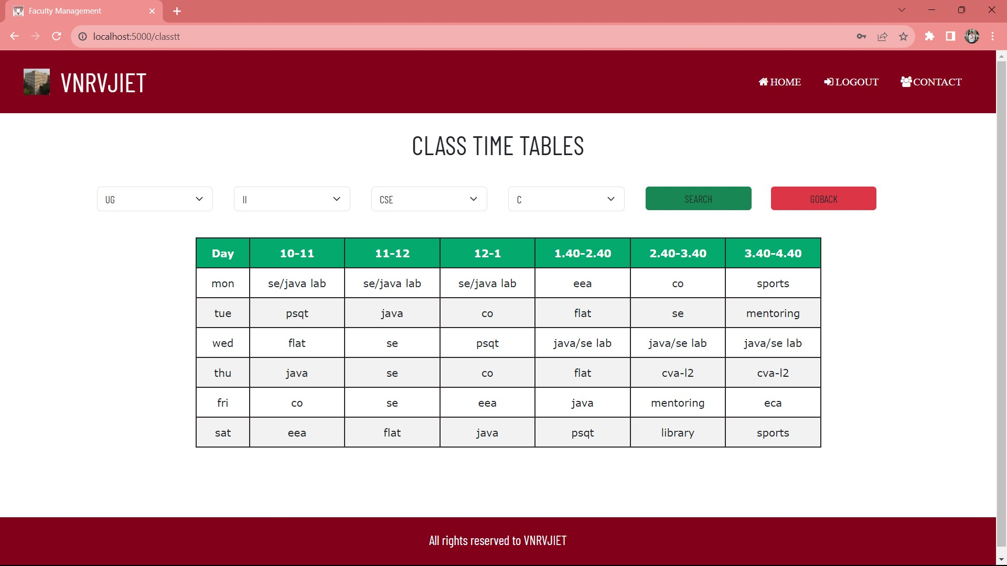
CLASS TIME TABLES

Slide 17
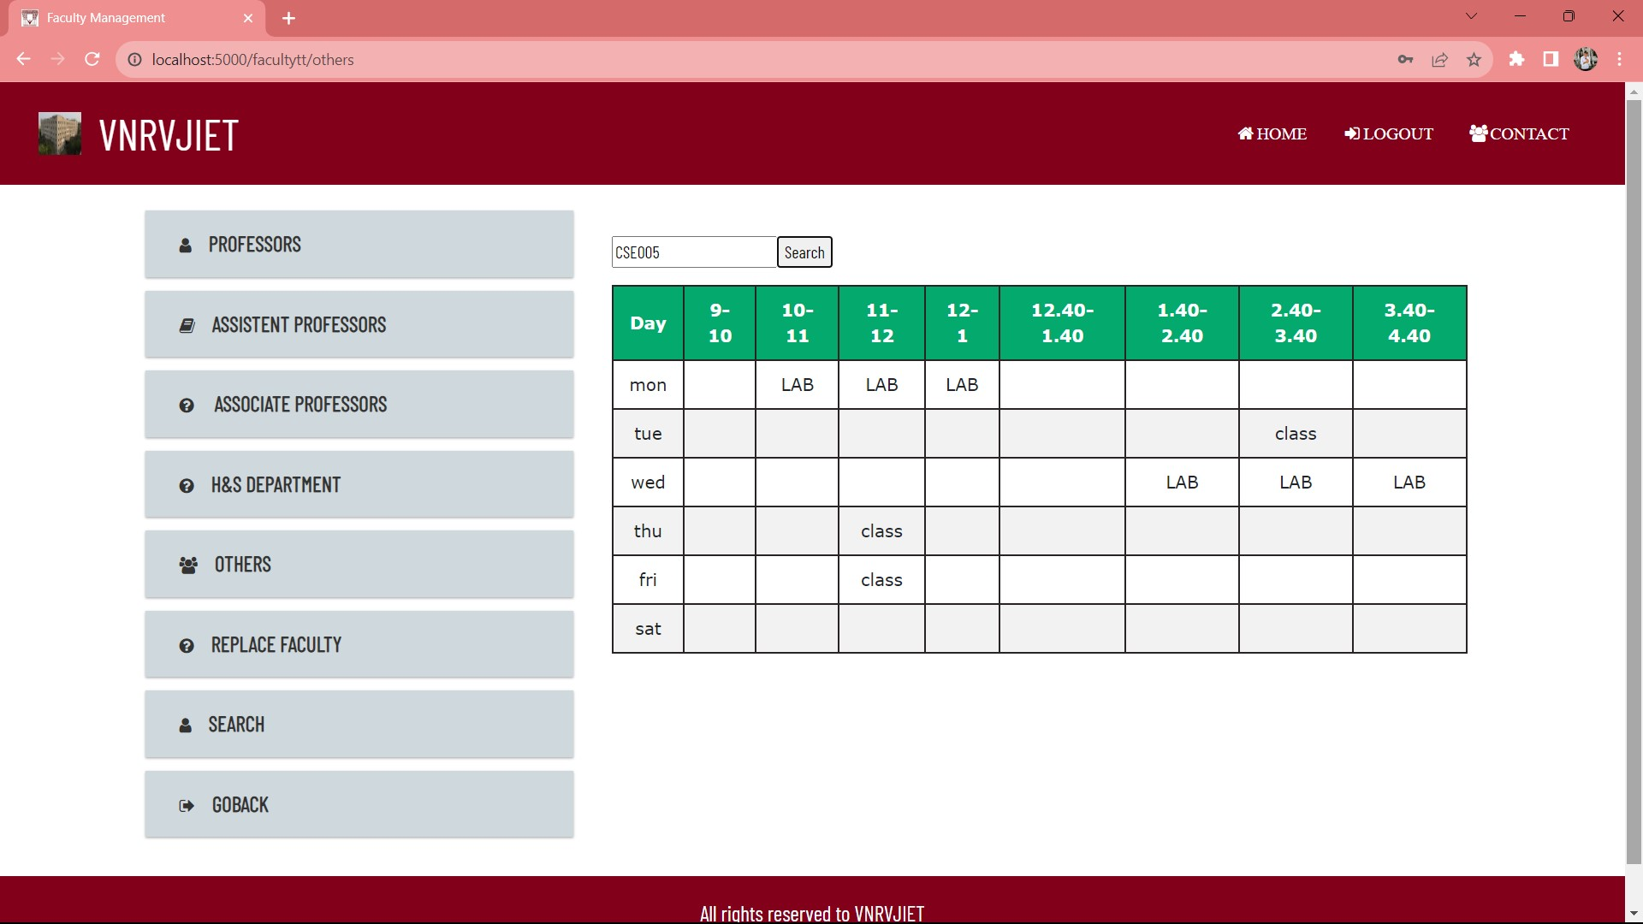
FACULTY TIME TABLES

Slide 18
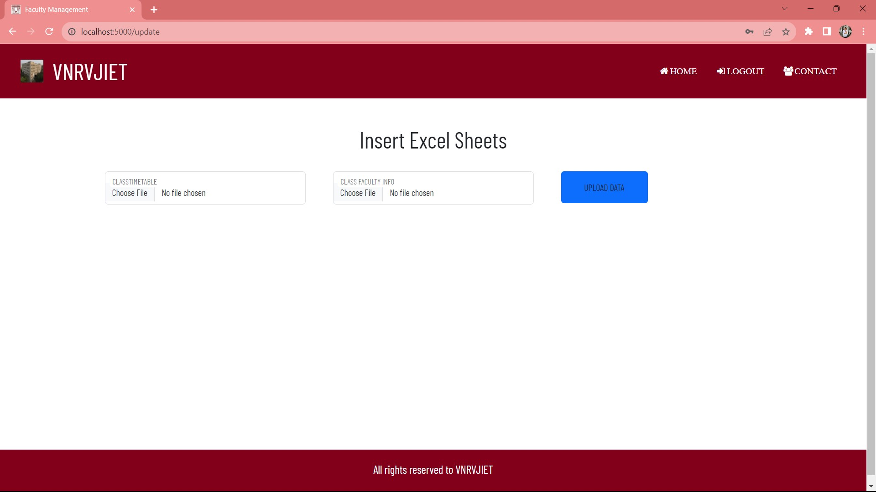
UPDATE DATA

Slide 19
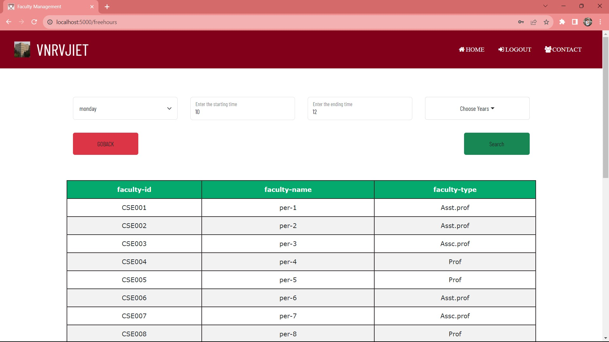
FREE HOURS PAGE

Slide 20
THANK YOU

